Slide 1
STARTING A NEW PIZZA PLACE? BUT WHERE IN BAY AREA?

Slide 2
Problem at hand
Market competition is sky rocketing.
Demand and competition varying from location to location.
A deep analysis of the location need to be done before starting a new business.

Slide 3
Who will be interested
People looking to open a new pizza place.
Small pizza restaurants looking for expansion.
Established restaurants to explore new opportunities.

Slide 4
Data Acquisition
“San Francisco Neighborhoods as ZIP Codes" from San Francisco Burden of Disease & Injury Study is used to get the zip codes and population.
“pgeocode” library is used to get the geo data of the neighborhood.
Foursuqre api is used to obtain data related to venues of each neighborhood.

Slide 5
Data cleaning and preprocessing
Venues marked as “pizza place”, “bakery”, and “Italian Restaurant” are filtered and a new dataset is created as “No of pizza places” with the total number of above venues in each neighborhood.
The ration between number of pizza places and population is calculated and added to the data frame.

Slide 6
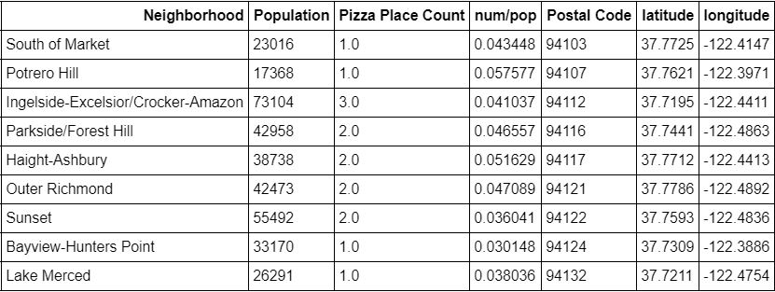

Slide 7
Clustering
K-Means clustering is used.
Neighborhoods are clustered according to the ratio between number of pizza places and population.
The optimal number of clusters is found using “elbow joint” method.

Slide 8
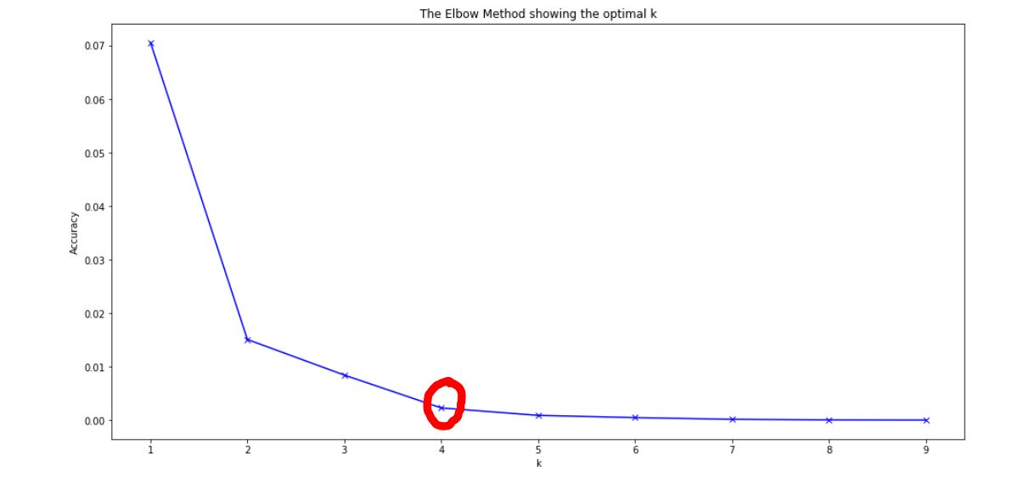
Elbow joint method

Slide 9
Results
4 Clusters have been identified.
Cluster 0 : Little or no competition
Cluster 2 : High competiton
Cluster 2 : Medium competition
Cluster 3 : Small competition

Slide 10
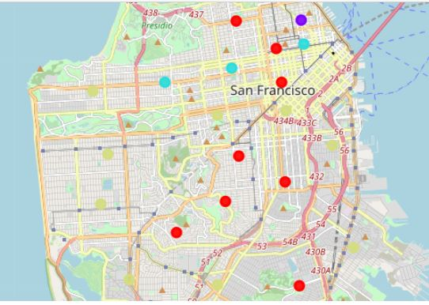
Neighborhoods after clustering
Cluster 0
Cluster 3
Cluster 2
Cluster 1

Slide 11
Discussion
Cluster 0 is identified as the best option for a new pizza place to be stared as it has the lowest competition.
Cluster 1 has a heavy competition thus not suitable for a new comer.

Slide 12
Conclusion
Only population and number of existing pizza places are considered.
More factors affect the success of a business.
GDP
Cost of living
Taxes
People’s interests
More updated data is necessary.

Slide 13
Thanks!
Any questions?
You can find me at herath.charithjay@gmail.com

